Slide 1

Predict Podcast Listening Time
Presentation by:
Lcndr Aquino, Luis Chavez, Yen Tung Lin, Joe Miranda and Huilin Zhang

Slide 2
Agenda
01 | Project Overview
02 | Team Roles
03 | Data Preparation & Cleaning
04 | Feature Engineering
05 | Model Development
06 | Factor Analysis & Pattern Exploration
07 | Implementation Details
08 | Results Summary
09 | Results Summary Pt. 2
10 | Results & Evaluation Summary Explained
11 | Conclusion

Slide 3

01 Project Overview
Goal:
Predict how long users listen to podcast episodes based on episode features.
Dataset Includes:
Numerical + categorical data (length, ads, publication time, popularity, etc.)
Analysis models used:
Linear Regression, Decision Tree, Random Forest, LightGBM, and XGBoost
Objective:
Find the most accurate and generalizable model for predicting listening time

Slide 4
02 Team Roles
Member | ROLE | Key Responsibilities
Joe Miranda | Project Lead | Managed meetings, deadlines, review final code and compile report
Huilin Zhang | Data Lead | Cleaned datasets, handled missing data, normalized formats
Luis Chavez | Feature Lead | Engineered new variables, analyzed correlations
Yen Tung Lin | Model Lead | Built and tuned ML models
Lcndr Aquino | Evaluation Lead | Conducted evaluation, calculated metrics, cross-validation

Slide 5

03 Data Preparation & Cleaning
Initial dataset:
Included podcast episodes and listen behavior
Cleaning steps include:
Removing duplicates and irrelevant ID columns
Handling missing values (imputation or removal)
Standardizing categorical text (e.g., genre, publication time)
Detecting and capping numerical outliers (e.g., episode length)
Final outputs:
clean_train.csv and clean_test.csv

Slide 6
04 Feature Engineering
Created new variables
ads_per_min
popularity_combo
prime_time
Encoded Categorical Variables
Genre
Publication Time
Sentiment
Scaled number features
Linear Regression
KNN

Slide 7

05 Model Development
Models Test:
Linear Regression (baseline)
Evaluation Metrics:
RMSE (Root Mean Squared Error)
Result
LightGBM and XGBoost showed best accuracy and generalization
Decision Tree, Random Forest (tree-based)
LightGBM, XGBoost (boosting models)
MAE (Mean Absolute Error)​

Slide 8

06 Factor Analysis & Pattern Exploration
Used Principal Component Analysis to reduce data complexity
Applied K-Means Clustering to find similar podcast groups
Insights:
Evening-released, long episodes w/ fewer ads = higher listening time
Reinforced findings from model results

Slide 9
07 Implementation Details
Language | Python
Tools /Libraries | pandas, numpy, scikit-learn, lightgbm, xgboost, matplotlib, seaborn
Environment | Jupyter Notebooks
Version Control | GitHub for collaboration and tracking changes

Slide 10
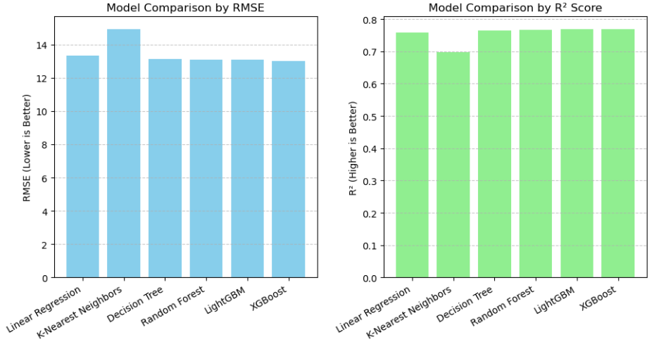
08 Results Summary
Model Comparison Bar Charts

Slide 11
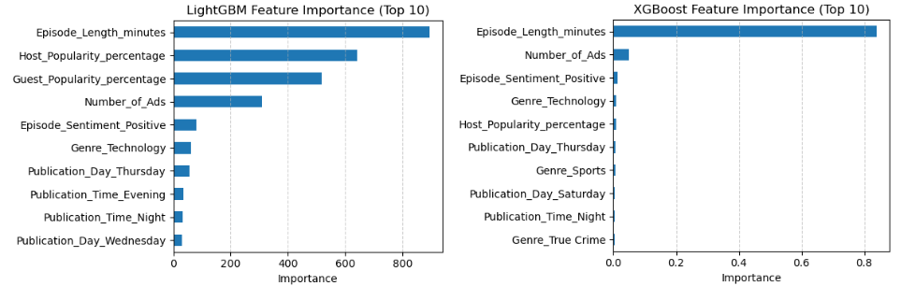
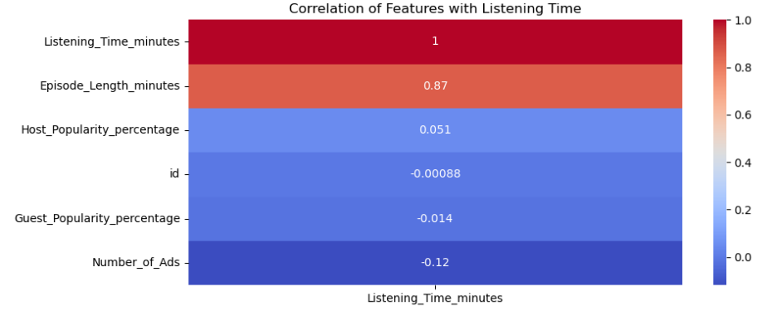
09 Results Summary Pt. 2
Feature Importance
Correlation of Features with Listening Time
​

Slide 12
10 Results & Evaluation Summary Explained
Boosting models (LightGBM, XGBoost) achieved lowest RMSE
Random Forest performed well; Decision Tree slightly overfit
Linear Regression provided interpretability
Ensemble models had stable performance across 10-fold cross-validation
Ensemble methods provided strongest performance and generalization
Linear Regression useful for explaining variable influence
Findings confirmed that data preprocessing and feature engineering improved model accuracy

Slide 13

11 Conclusion
Episode Length = strongest predictor of listening time
Other factors , like host/guest popularity, ad count, genre, had secondary influence
Longer episodes naturally yield more listening time
LightGBM and XGBoost captured this relationship best

